Slide 1


Kids Can't Fly
Not to be confused with KFC
By: Samuel Downs, Minh (Joey) Nguyen

Slide 2
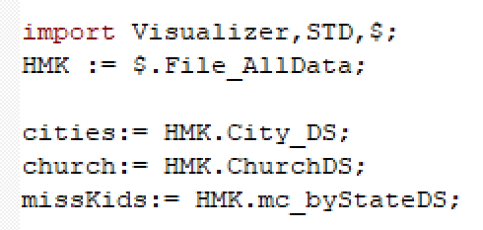
Data Importation
For this project, three tables were used: City_DS, ChurchDS, and the NCMEC datasets
We will be able to relate the number of missing children in a county fib with the number of churches in that county fib

Slide 3
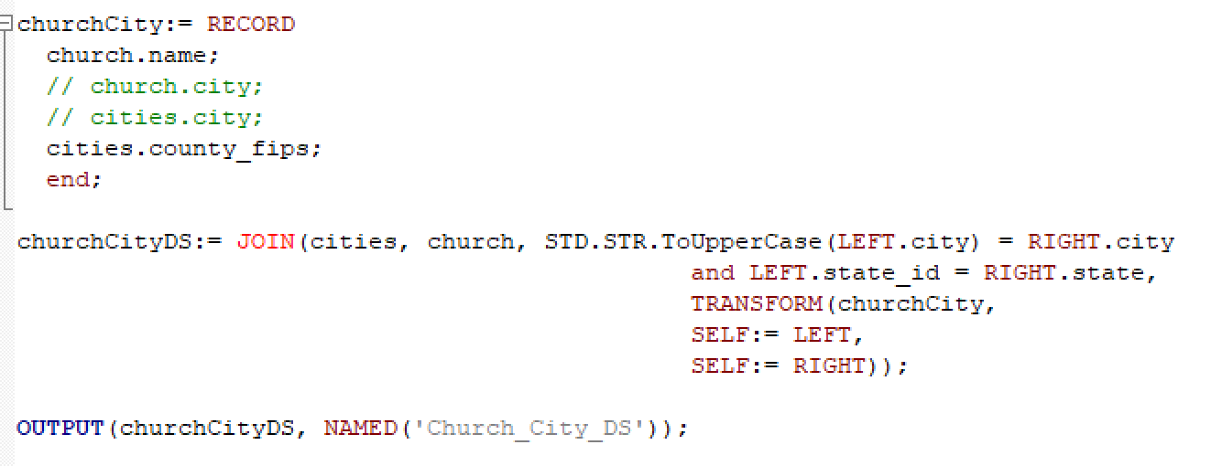
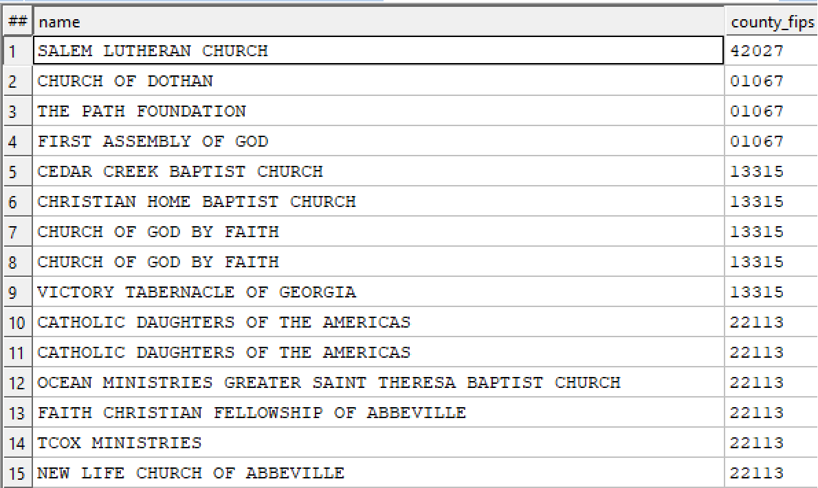
Finding the Fib Numbers for each Church

Slide 4
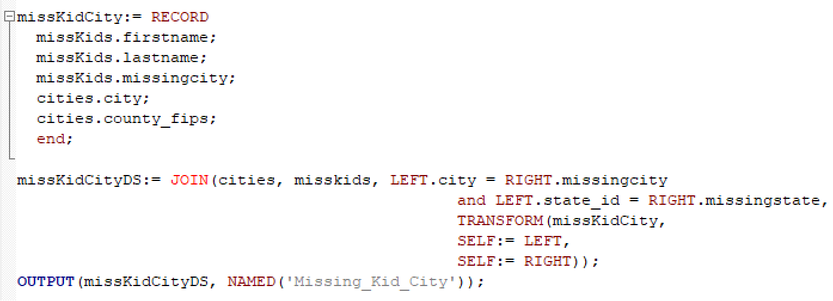
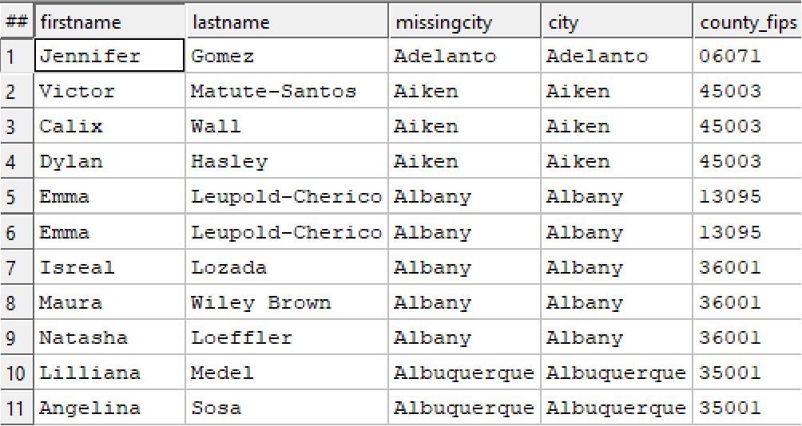
Finding the Fib Numbers for each Missing Child

Slide 5
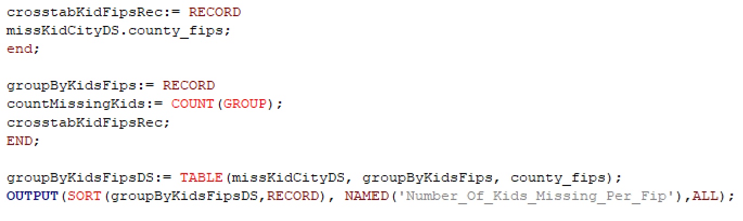
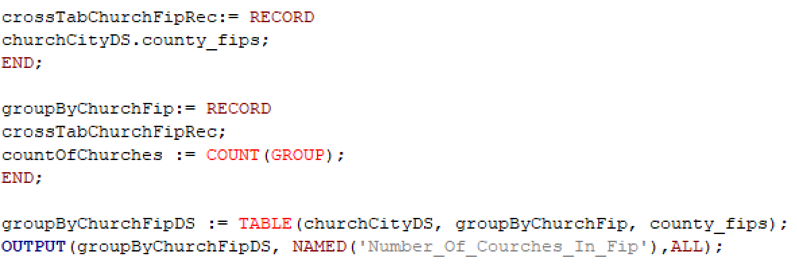
Grouping the Missing Children and Church Datasets by the Fib Number

Slide 6
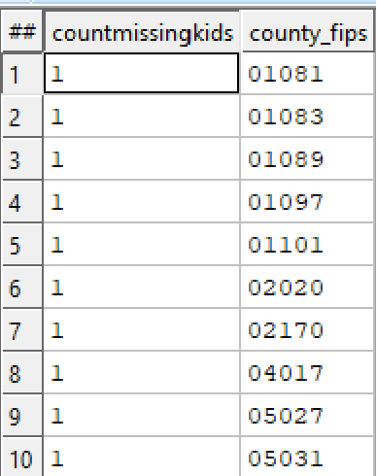
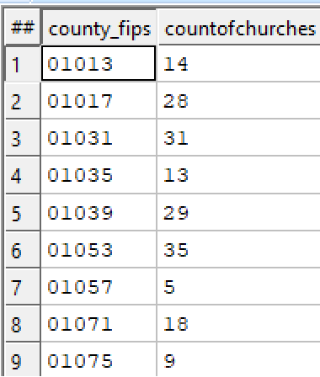
Each Grouped Dataset

Slide 7
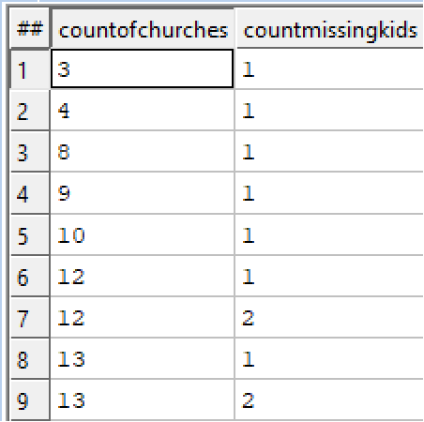
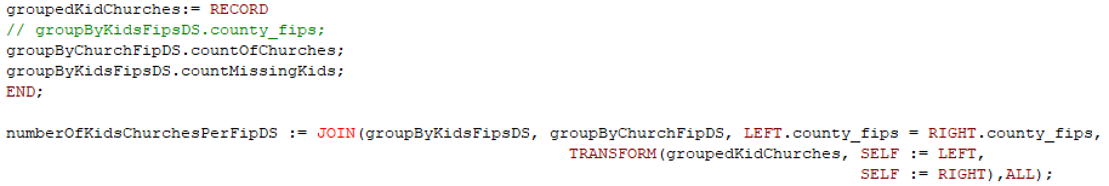

Slide 8
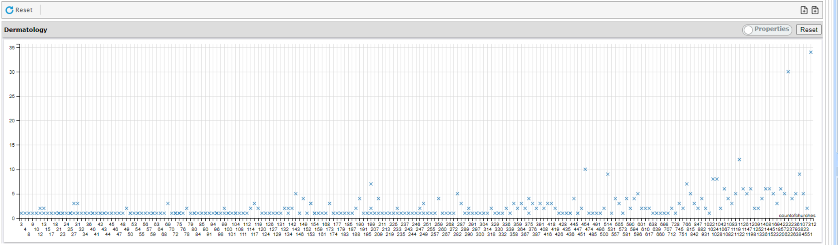
Comparing number of missing children to number of churches in the area (per county fib)

Slide 9
Results
Is there a correlation between the number of churches in an area and the number of missing children? (is our results conclusive enough?)
Is there any bias that can throw off our result? (denser population can equal higher number of churches)
Is there any extra information about each church to better determine a correlation? (type of religion, whether the church is in the bible belt)
Is there a better way to visualize the church-children information? (Future Features)

Slide 10
Future Features
Make a heatmap to show the concentration of churches overlapped with the concentration of missing children (to better show missing children reports in relative to the position of churches on a map)
Account for population bias

Slide 11
Problems with Development
Only one person had experience with database languages (oracle and SQL), but no experience with ECL before this hackathon.
This inexperience caused one person to work on the majority of the project; this person also had to get used to the ECL IDE and querying/visualizing using ECL.

Slide 12

Demo Video

Slide 13
Questions?

